Slide 1
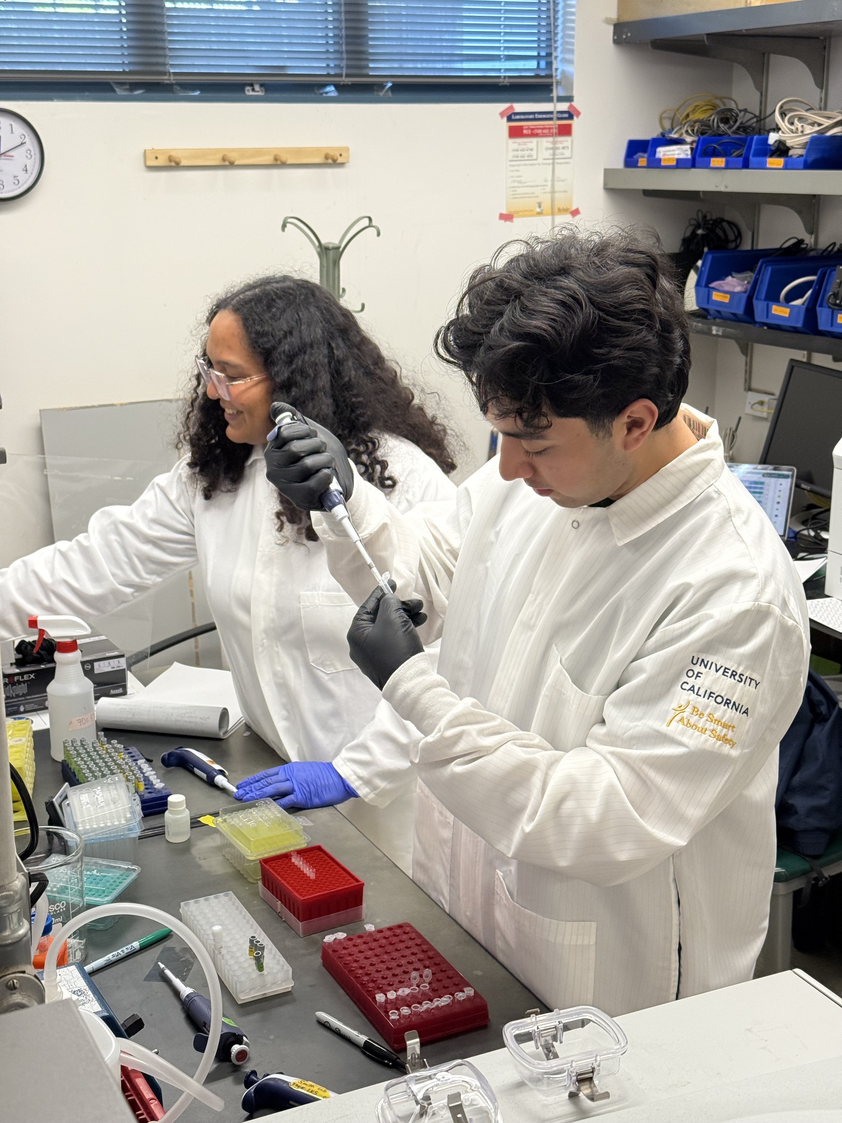
Biological Burden of Chronic Stress among Latinx Adolescents with Asthma
Asthma and Stress
Research Question
What I Learned
Asthma is disproportionately higher among Black and Latinx children 64% of Richmond (Binney et al., 2024; Grant et al., 2022)
Social and environmental stressors contribute to 40% of asthma exacerbations (Künzli et al., 2008).
Does mitochondrial function serve as an early biomarker of psychosocial stress and increased asthma risk?
Quantify DNA concentration through PicoGreen Assay
Run a qPCR plate for our samples
Learned to conduct literature review
Research Methods
Richmond Environment and Asthma Community Health (REACH) Study
Stress
Mitochondrial function
Asthma
Categories | No asthma N=29 | Asthma N=41
Age, Median (IQR) | 12 (11.00, 14.00) | 11 (10.00,13.00)
Race/ethnicity, N (%)
Non-Hispanic White | 0 (0.00) | 0 (0.00)
Non-Hispanic Black | 2 (6.90) | 0 (0.00)
Hispanic | 26 (89.66) | 39 (95.12)
Other | 1 (3.45) | 2 (4.88)
Income below federal poverty level, N (%) | 18 (62.07) | 25 (60.98)
Perceived Stress scale score, median (IQR) | 14 (10.00, 20.00) | 18.00 (15.00, 23.00)
Next steps
Quantify mtDNAcn among REACH participants
Using our questionnaire data, we will examine associations between perceived stress and mitochondrial DNA copy number
We will examine differences in mitochondrial DNA copy number between participants with and without asthma
The mitochondria is part of the cell that provides energy for the cell
Examining the health of the mitochondria linked to disease
Mitochondrial DNA copy number (mtDNAcn) has been associated with greater asthma risk in adults
Questionnaire data captures psychosocial stressors across multiple domains and levels
Quantitative Polymerase Chain Reaction qPCR can capture the amount of a specific DNA gene in a sample.

